Slide 1
Design and Analysis of Algorithms

Slide 2
DP Steps
Divide the problem into subproblems
Storing the sub solutions in a table (memorization)
Bottom-up computation: Starts at smallest problem instance and develops the solution to sub instances of longer size.

Slide 3
DYNAMIC PROGRAMMING
The idea of dynamic programming is thus quit simple: avoid calculating the same thing twice, usually by keeping a table of known result that fills up a sub instances are solved.
In dynamic programming the principle of optimality is used to reduce the decision sequences.
Principle of optimality:
An optimal sequence of decisions has the property that whatever the initial state and decisions are, the remaining decisions must constitute an optional decision sequence with regard to the state resulting from the first decision.
.

Slide 4

Sequence Of Decisions
Decide the x_{i} values in the order x₁, x₂, x₃, …, x_{n}.
OR
Decide the x_{i} values in the order x_{n}, x_{n-1}, x_{n-2}, …, x₁.

Slide 5
Divide and conquer is a top-down method.
When a problem is solved by divide and conquer, we immediately attack the complete instance, which we then divide into smaller and smaller sub-instances as the algorithm progresses.
Dynamic programming on the other hand is a bottom-up technique.
We usually start with the smallest and hence the simplest sub- instances.
By combining their solutions, we obtain the answers to sub-instances of increasing size, until finally we arrive at the solution of the original instances.
The essential difference between the greedy method and dynamic programming is that the greedy method only one decision sequence is ever generated.
In dynamic programming, many decision sequences may be generated. However, sequences containing sub-optimal sub-sequences can not be optimal and so will not be generated.

Slide 6
All-Pairs Shortest Path Problem
Let G=( V,E ) be a directed graph consisting of n vertices.
Weight is associated with each edge.
The problem is to find a shortest path between every pair of nodes.

Slide 7
Idea of Floyd-Warshall Algorithm
Assume vertices are {1,2,……n}
Let A^{k}( i, j ) be the length of a shortest path from i to j with intermediate vertices numbered not higher than k where 0 ≤ k ≤ n, then
A⁰( i, j )=c( i, j ) (no intermediate vertices at all)
A ^{k}( i, j )=min { A^{k-1}( i, j ), A^{k-1}( i, k )+ A^{k-1}( k, j ) }
  and A ^{n}( i, j ) is the length of a shortest path from i to j

Slide 8
In summary, we need to find A ^{n} with A ⁰ =cost matrix .
General formula
A^{k} [ i, j ]= min { A^{k-1}[ i, j ], A^{k-1}[ i, k ]+ A^{k-1}[ k, j ] }

Slide 9
Shortest path using intermediate vertices
{ V₁, . . . V_{k} }
d ^{k-1}[i, k]
V_{k}
d ^{k-1}[k, j]
V_{j}
V_{i}
d ^{k-1}[i, j]
Shortest Path using intermediate vertices
{ V_{1, . . .} V_{k -1} }

Slide 10
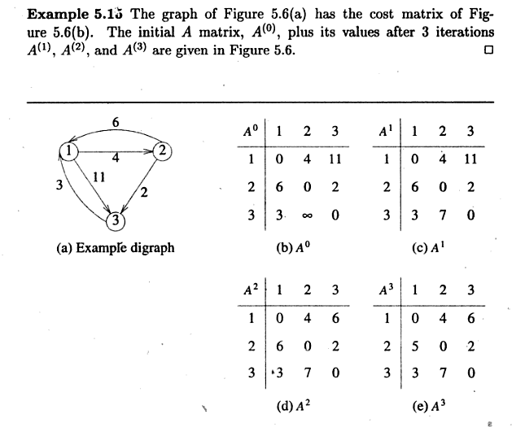

Slide 11
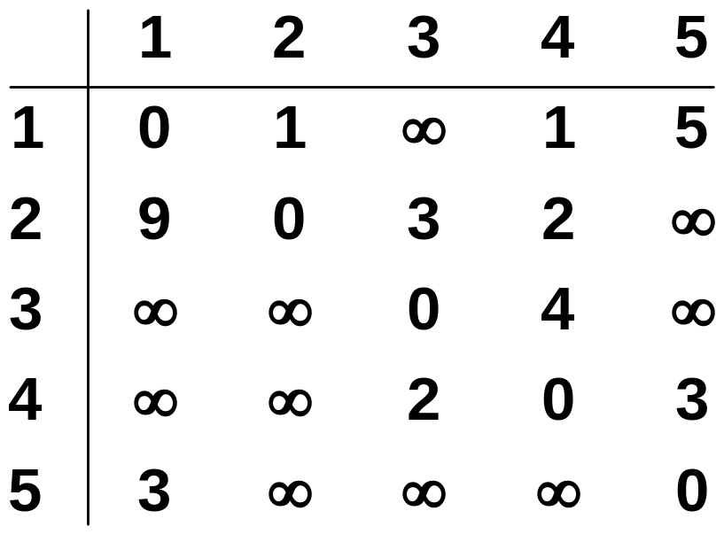
Example:-
1
3
v₁
v₂
9
5
1
2
3
v₅
3
2
v₄
v₃
4

Slide 12
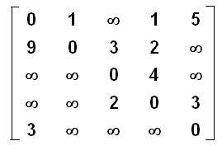
A⁰ =
A¹ =
A² =
A³ =
A⁴ =
A⁵ =

Slide 13
Algorithm
Algorithm AllPaths( c, A, n )
// c[1:n,1:n] cost matrix
// d[i,j] is the length of a shortest path from i to j
{
for i := 1 to n do
for j := 1 to n do
A [ i, j ] := c [ i, j ] ; // copy c into d
for k := 1 to n do
for i := 1 to n do
for j := 1 to n do
A [ i, j ] := min ( A [ i, j ] , A[ i, k ] + A [ k, j ] );
}
Time Complexity is O ( n ³ )

Slide 14
Program
#include<stdio.h>
#include<conio.h>
#include<math.h>
int p[10][10];
int min(int,int);
void warshal(int p[10][10],int n)
{
int i,j,k;
for(k=1;k<=n;k++)
for(i=1;i<=n;i++)
{
for(j=1;j<=n;j++)
p[i][j]=min(p[i][j],p[i][k]+p[k][j]);
}
}
int min(int a,int b)
{
if(a<b) return(a);
Else return(b);
}
void main()
{ int n,i,j; clrscr();
printf("\n Enter the number of vertices:");
scanf("%d",&n);
printf("Enter the adjacency matrix");

Slide 15
for(i=1;i<=n;i++)
{
for(j=1;j<=n;j++)
scanf("%d",&p[i][j]);
}
for(i=1;i<=n;i++)
{
for(j=1;j<=n;j++)
printf("%d\t",p[i][j]);
printf("\n");
}
warshal(p,n);
printf("\n Shortest Path to all pairs \n");
for(i=1;i<=n;i++)
{
for(j=1;j<=n;j++)
printf("%d\t",p[i][j]);
printf("\n");
}
getch();
}

Slide 16
